Slide 1

Notes:
Presenter: Doug Bass

Slide 2






Go2Group Services
Worldwide leaders in ALM solutions since 2002
Specialists in complex integration and migration
Certified by Atlassian, HP, IBM, Perforce, Microsoft
Notes:
Presenter: Doug Bass
Go2Group has been solving complex issues for 13 years. We specialize in complex integrations and migrations and are experts in all the leading solutions.

Slide 3

Experienced
Thousands of enterprise-level migrations
  First Atlassian Partner in North America and Japan
  2000+ plugin installations
  Hundreds of active clients, over 70+ countries
  GSA Listed
Notes:
Presenter: Doug Bass
We’ve implemented software productivity systems for hundreds of clients in all industries, worldwide.

Slide 4
“Simplifying Complex ALM Tools at IGT Gaming”
Notes:
Presenter: Madhu Prakhya

Slide 5

Madhu Prakhya
Quality Project Manager, IGT
Notes:
Speaker introduction – (profile pic missing)

Slide 6
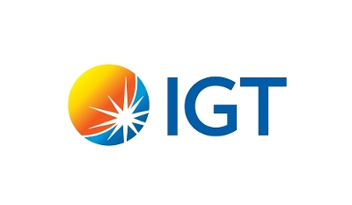
About IGT
Leading gaming and lottery systems company
Gambling since 1975
10k+ employees spread across offices – UK, USA, China, Italy, Australia and more
Notes:
Founded in 1975

Slide 7
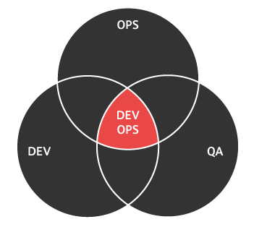
DevOps at IGT
Dev team used JIRA – requirements management tool
Quality team used HP ALM/Quality Center for 2 reasons:
  maintain all test cases within the quality team
  ability to run and manage test cases – all in one tool
Notes:
Quality management process at IGT

Slide 8
What happened on July 16, 2014?
Notes:
Acquisition of IGT by Gtech

Slide 9


Acquisition of IGT..
Notes:
Only July 16, 2014 Gtech acquired IGT for $4.7 billion cash and stock.

Slide 10
After Acquisition..
Quality systems
  Gtech used JIRA
  IGT used HP ALM/Quality Center
There existed diversified teams – different processes, thinking, languages, and workflows
ALM Silos
Notes:
After the acquisition, there was complexity in ALM integration at IGT
How would you measure the problems?

Slide 11
Was the problem so large that it had to be resolved?
Notes:
What made the problem so large that it had to be solved

Slide 12
Enterprise Challenge
No sharing information between teams using different solutions – JIRA and Quality Center
No visibility in the process – Global teams couldn’t work together
No seamless integration between teams, workflows and systems
No accurate reporting across all testing phases
Notes:
After the acquisition, there was complexity in ALM integration at IGT
How would you measure the problems?

Slide 13
“There was a need for Babel Fish.”
— Manager, IGT
Notes:
ConnectALL = Babel Fish

Slide 14


ALM Router
Notes:
IGT considering ConnectALL ALM Router as the ultimate integration solution.

Slide 15










ALM Silos
Notes:
ALM systems don't talk to each other or share data, users can’t see or change items in systems they don't use. Some users are forced to access multiple systems over and over again.

Slide 16
ConnectALL Tears Down Walls
TM
ALM Router
Notes:
ConnectALL removes the barriers by synchronizing data between systems. Each user sees all the tasks and projects in the system that’s best for that user! ConnectALL connects them all!

Slide 17



Why ConnectALL ALM Router?
Agility
Availability
Administrative
Notes:
3 highlights about ConnectALL

Slide 18
Agility
Tremendous integration flexibility
High customization access
Easy to define workflows
User friendly interface

Slide 19
Availability
Easily adopted by global teams of all sizes
Make distributed teams feel like a part of homogeneous large system
Licensing policy is flexible and meaningful
Ready-to-use solution with less customization for implementation
Great training

Slide 20
Administrative Capability
Low maintain
Go-live phase is short and easy
Easy to training resources and scale-up skill level
Dependable product support team
Ability to support and scale users from 30 to 3000

Slide 21
“Yes, we were able to establish high-fidelity sync between JIRA and HP Quality Center.”
— Quality Team, IGT
Notes:
IGT sees the benefits of using ConnectALL as the integration solution.

Slide 22
Workflow
Defects
Test Cases/Defects
Test Cases/Bugs
HP ALM/
Quality Center
Atlassian JIRA
ALM Router
Notes:
Sync test cases bi-directionally between JIRA and HP ALM

Slide 23
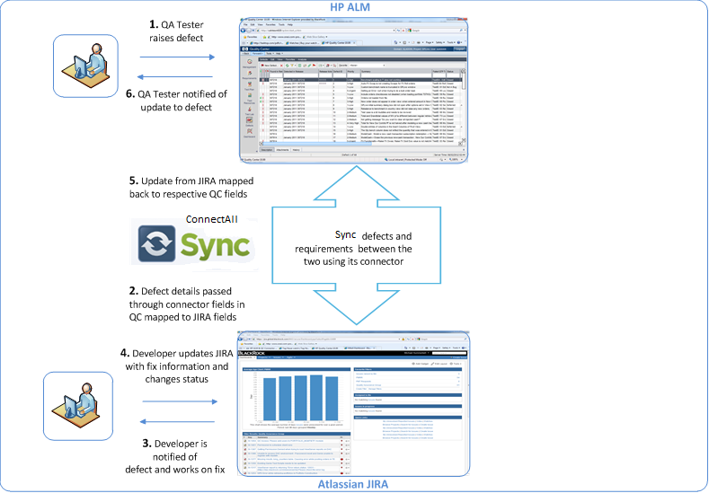
Connect Workflow
ALM Router

Slide 24
Perceived Value – IGT
Dynamically track progress of defects for business analysis
Enable accurate reporting across all testing phases
Allow individual teams to use their respective tools of choice for tracking and reporting artifacts
Enhanced visibility for both teams (QC and JIRA)
Notes:
what were the benefits to the development teams?
what were the benefits to the entire organization?
how would you measure it?
Top 5 takeways

Slide 25
Top Takeaways
ConnectALL ALM Router – simplifies complex ALM integration at enterprise level
Teams can work on systems of their choice and ConnectALL syncs all application data – automatically!
ConnectALL supports one-to-many project mapping between ALM systems
ConnectALL licensing – flexible to support unlimited projects and users

Slide 26
Learn More
www.go2group.com/connectall

Slide 27
Questions?

Slide 28
Thank You!
connectall@go2group.com
madhu.prakhya@igt.com

